Slide 1
Health Policy Issues
An Economic Perspective
Chapter 3

Slide 2
Chapter 3
Do More Medical Expenditures Produce Better Health?

Slide 3
LEARNING OUTCOME
Explore the factors that affect health levels and the most cost-effective improvements

Slide 4
Presentation
Medical Services Versus Health
Health Production Function
    Exhibit 3.1

Slide 5
Presentation (continued)
Improving Health Status Cost-Effectively
  Neonatal Infant Mortality Rate
    Exhibit 3.2
    Exhibit 3.3
  Heart Disease Mortality Rate
  Causes of Death by Age Group
    Exhibit 3.4

Slide 6
presentation (continued)
Relationship of Medical Care to Health over Time
  Exhibit 3.5
continue to discussion

Slide 7
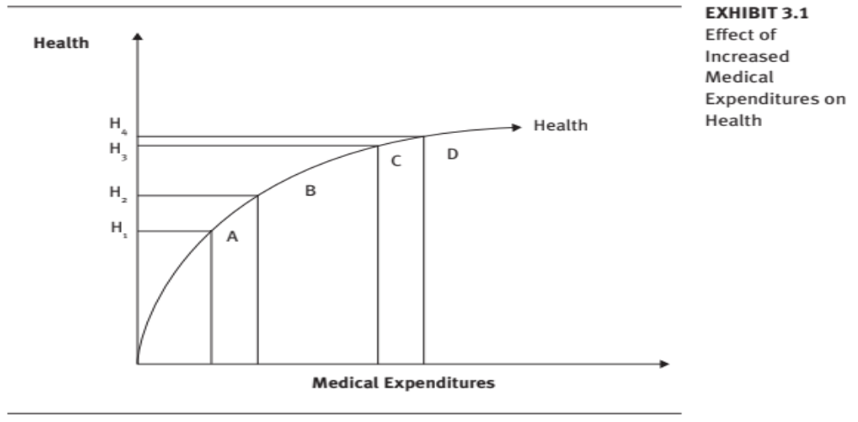
Effect of Increased Medical Expenditures on Health
Exhibit 3.1

Slide 8
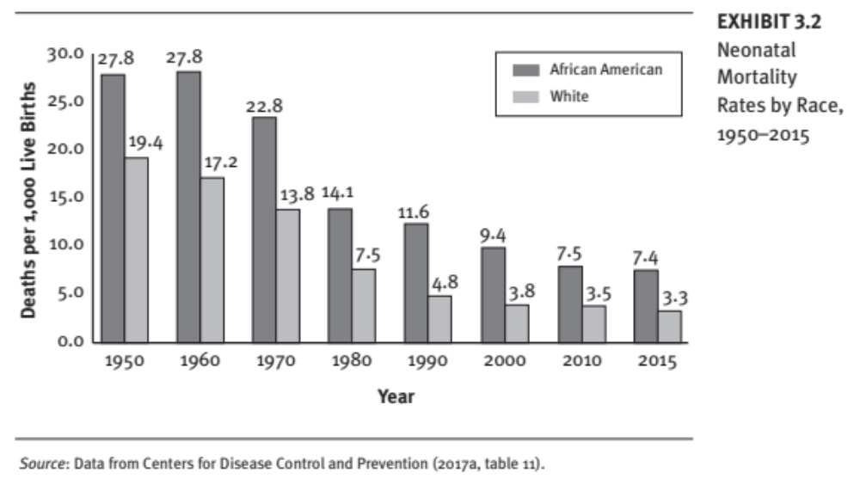
Neonatal Mortality Rates by Race 1950–2015
Exhibit 3.2

Slide 9
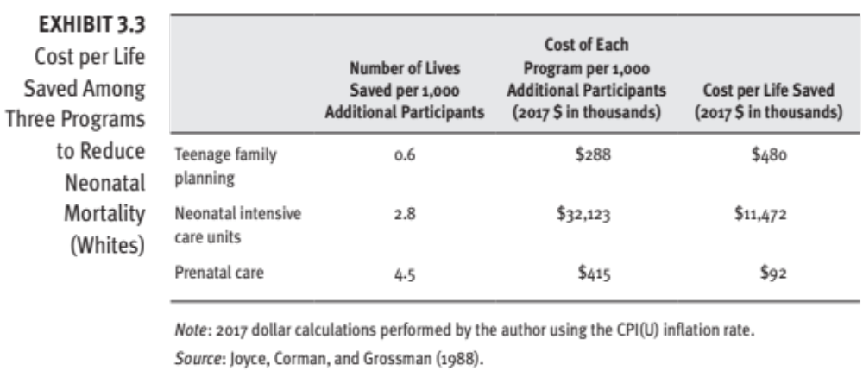
Cost per Life Saved Among Three Programs to Reduce Neonatal Mortality (Whites)
Exhibit 3.3

Slide 10
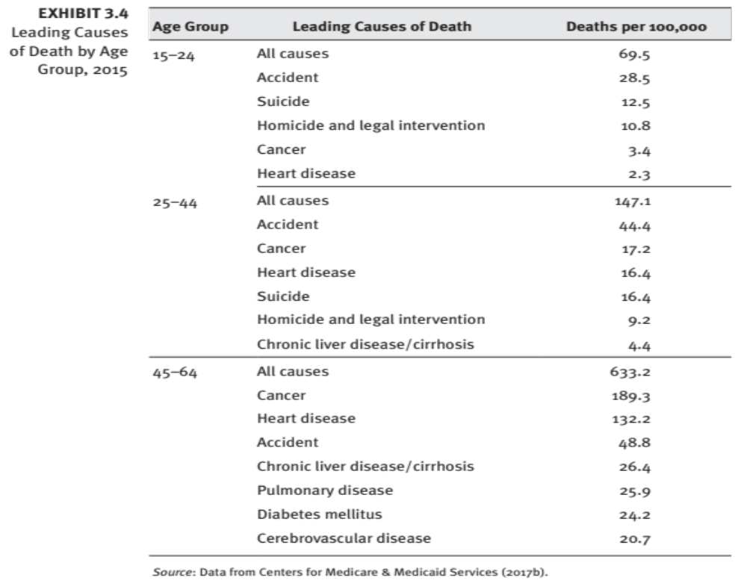
Exhibit 3.4
Leading Causes of Death by Age Group, 2015
return to presentation

Slide 11
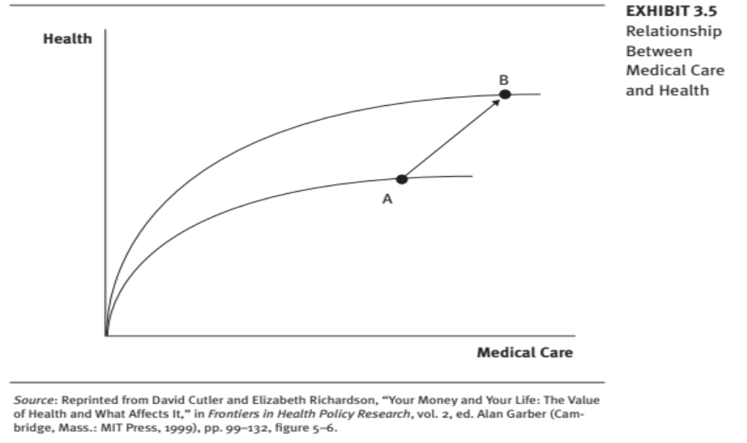
Relationship Between Medical Care and Health
Exhibit 3.5

Slide 12
Chapter Overview
United States spends more per capita on medical services and devotes a larger percentage of its Gross National Product to medical care than other countries,
  our health levels are not proportionately higher.
Is our Medical system less efficient at producing health than other countries,
  Or are medical expenditures less important than other factors that affect health levels?
This chapter explores these questions and points out that further expenditures on medical services are not the most cost-effective way to increase health levels.
Researchers concluded that
  changing lifestyle behavior offers the greatest promise for lowering mortality rates, at a much lower cost per life saved.

Slide 13
Some Highlights – Chapter 3
Economists have used the concept of a health production function to determine the relative importance of medical expenditures in decreasing mortality rates
Production Function
  HS is a function of (Med $; Lifestyle; edu; Env)
    HS= ($; LS; Ed;Env; Med; ?)
  For example:
    Nursing Patient Care is a function of: RNs; LVNs, N-Aids, type of unit
    As a manager you can achieve the output by mixing the combination of the inputs.

Slide 14
Discussion
The textbook includes a quote from V.R. Fuchs, who wrote, “The greatest potential for reducing coronary disease, cancer, and the other major killers still lies in altering personal behavior.”
What do you think are the major obstacles to altering personal behavior? How might they be overcome?

Slide 15
Summary
US medical care spending is increasing even though expenditures on medical services are less cost-effective in reducing mortality rates than are changes in lifestyle behavior because:
  Comprehensive health insurance coverage leads to low out-of-pocket price.
  A primary objective of government medical expenditures is to help the aged finance medical needs, rather than to improve health status and decrease mortality rates.

Slide 16
Summary (continued)
“Consumption” versus “investment” types of medical expenditures are appropriate as long as everyone involved recognizes them for what they are:
  Services that are not lifesaving may be appropriate personal expenditures.
  Financing medical services for those with low income is appropriate societal goal.

Slide 17
Summary (continued)
When government attempts to improve the health of its low-income populations, expenditures are directed toward the most cost-effective programs—those that result in the lowest cost per life saved and lead to a greater reduction in mortality rates for a given total expenditure than is possible with any other allocation method.

Slide 18
Summary (continued)
The recognition by the government, employers, health plans, and individuals that resources are scarce and that their objective should be to improve health status rather than use additional medical services will lead to new approaches to enhance health.

Slide 19
Summary (continued)
The health production function should clarify the trade-offs between different programs and improve the allocation of expenditures.

